Slide 1
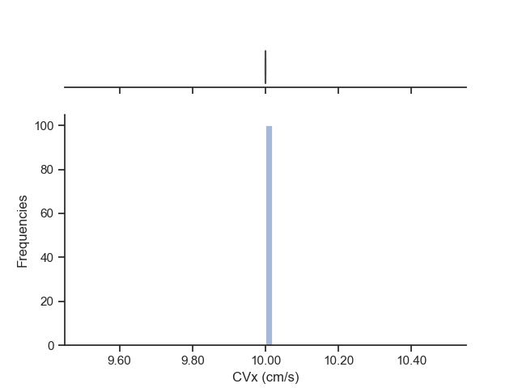
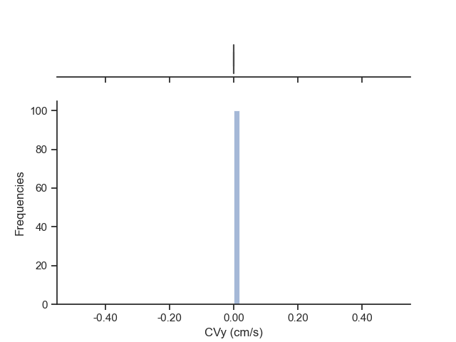

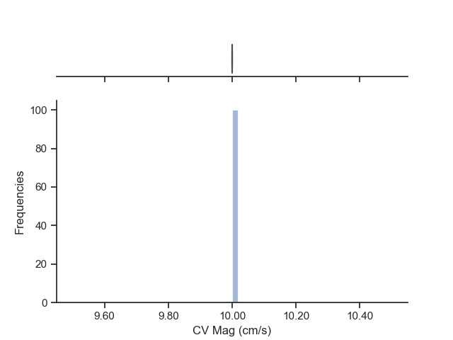
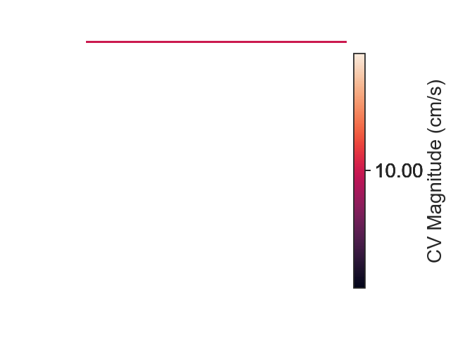
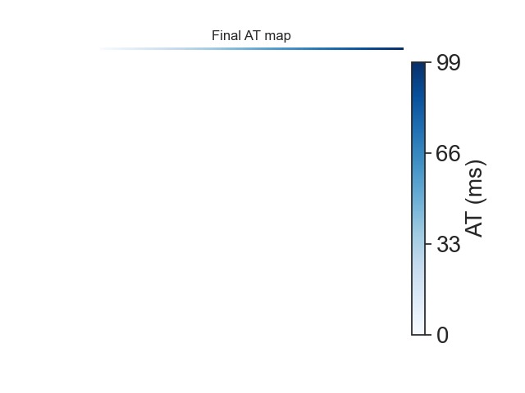
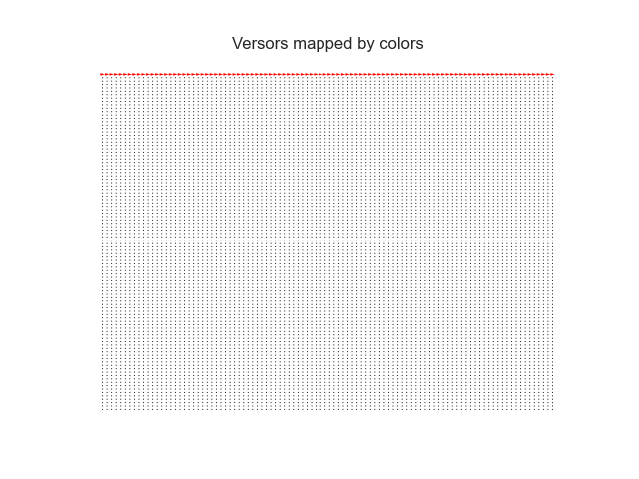
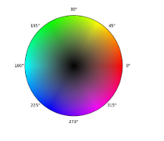
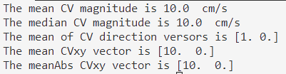
Sample artificial: one line in the up horizontal direction with AT from 0 (up-left) to 99 ms (up-right).

Slide 2
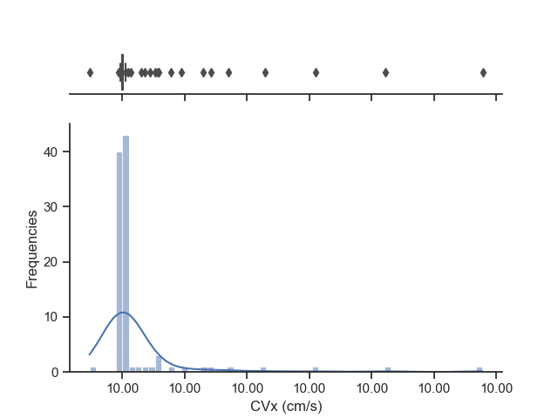
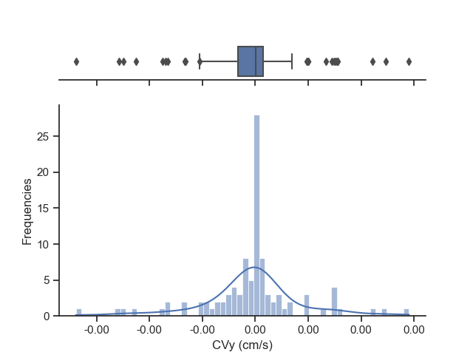
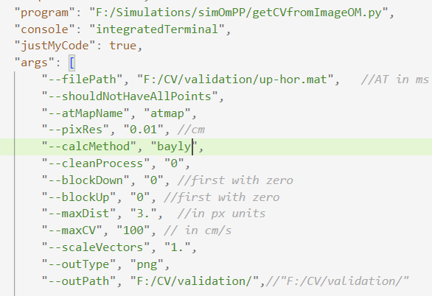
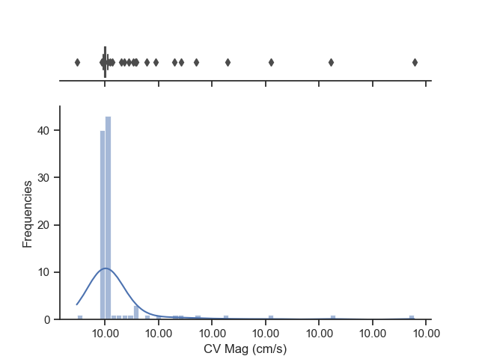
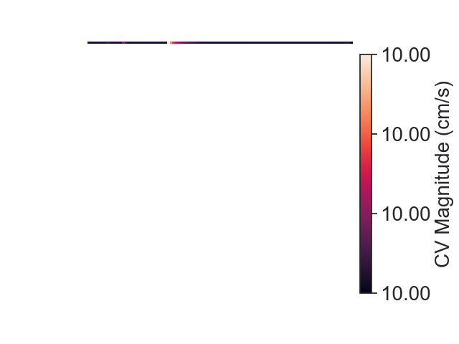
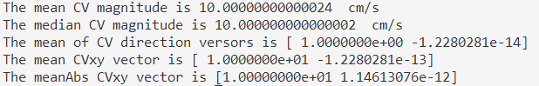
Sample: one line in the up horizontal direction with AT from 0 (up-left) to 99 ms (up-right).

Slide 3
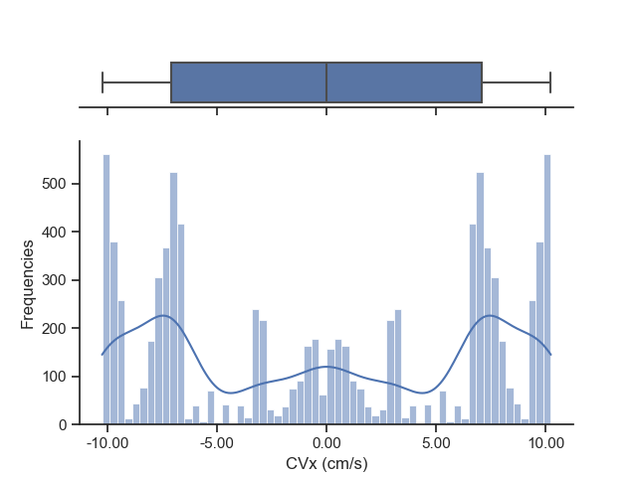
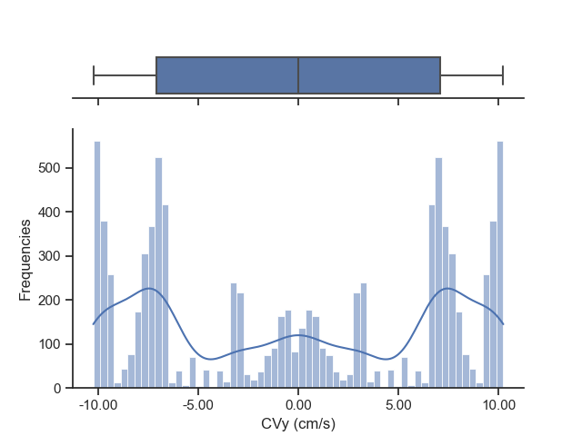
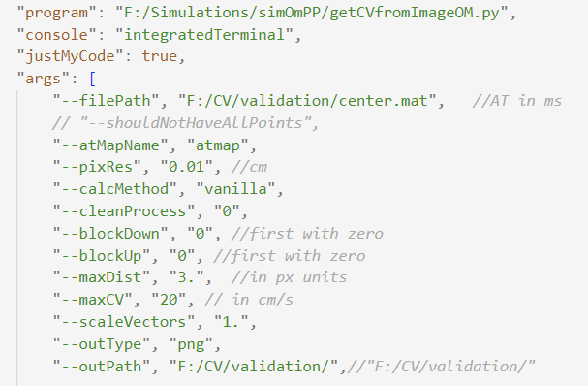
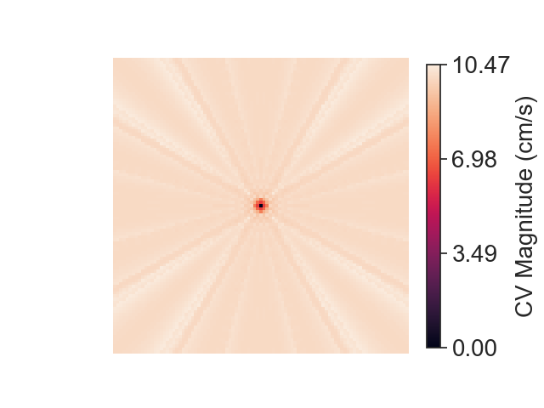
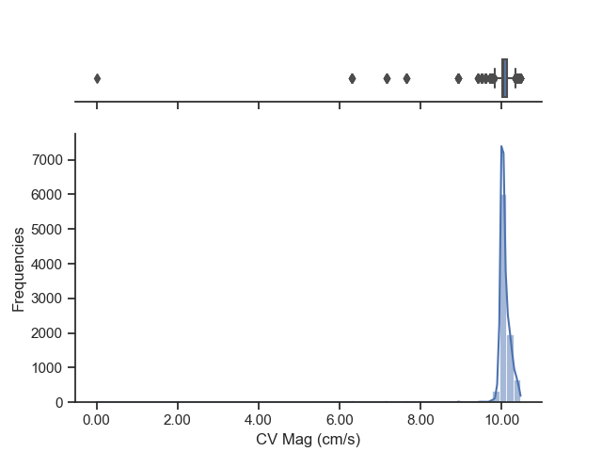
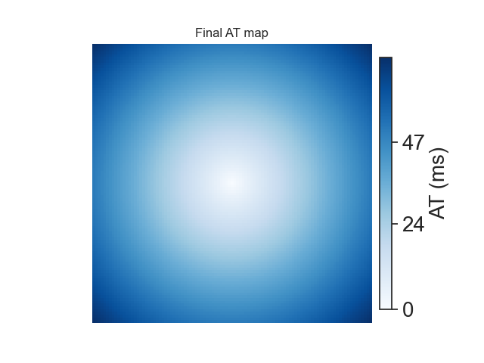
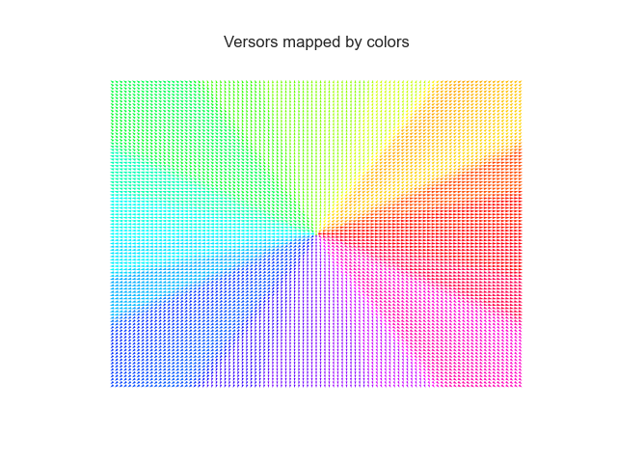
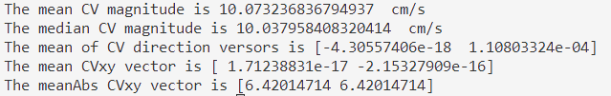
Sample: from center to the borders with AT= to the radius from the center. 101x101 image

Slide 4
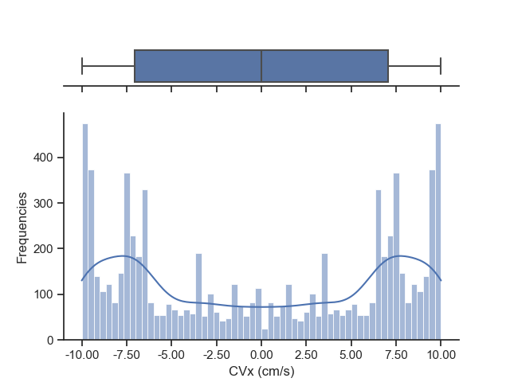
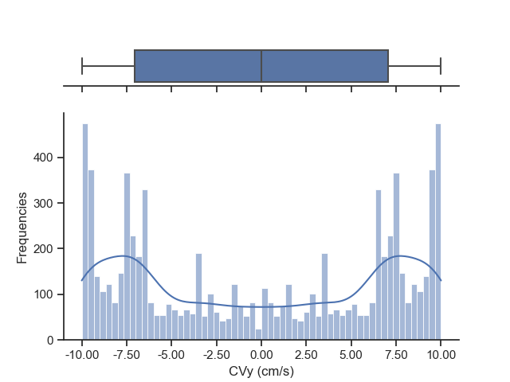

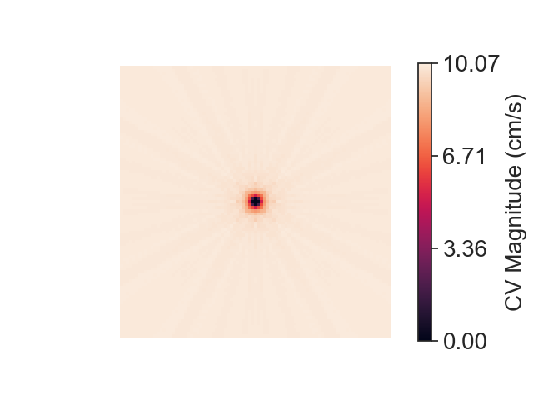
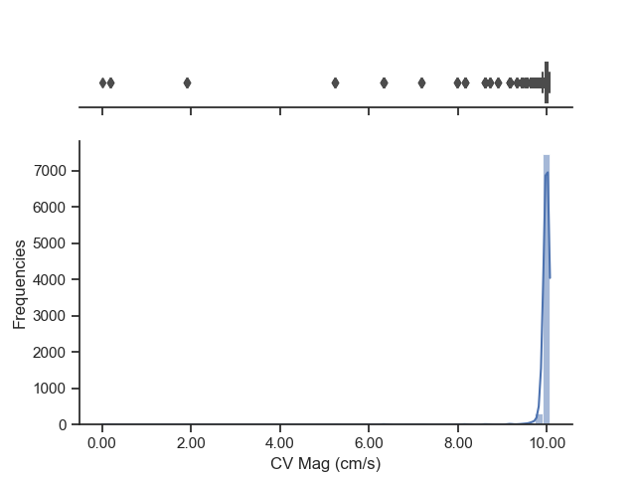
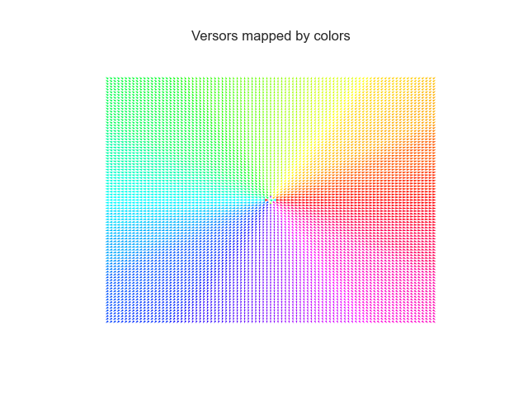
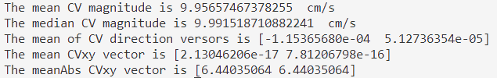
Sample: from center to the borders with AT= to the radius from the center. 101x101 image

Slide 5
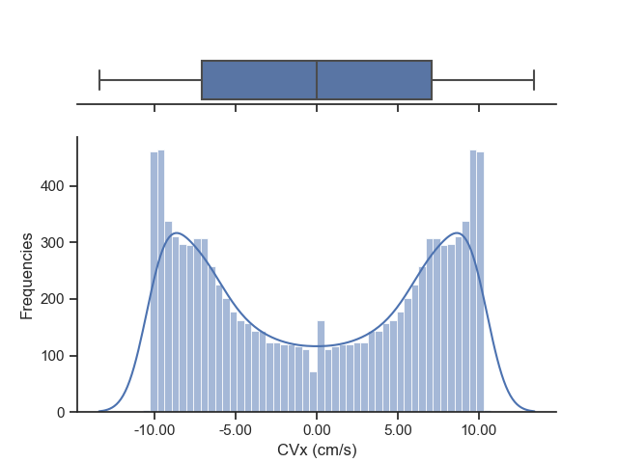

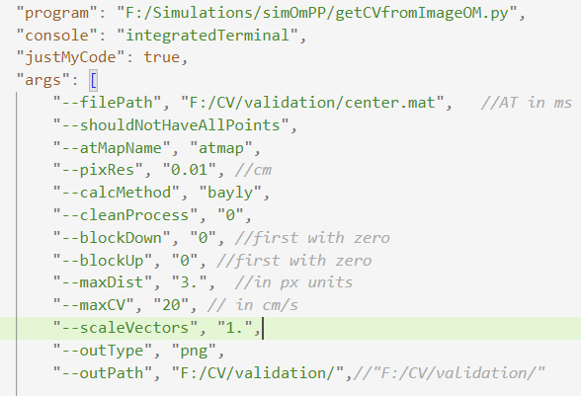
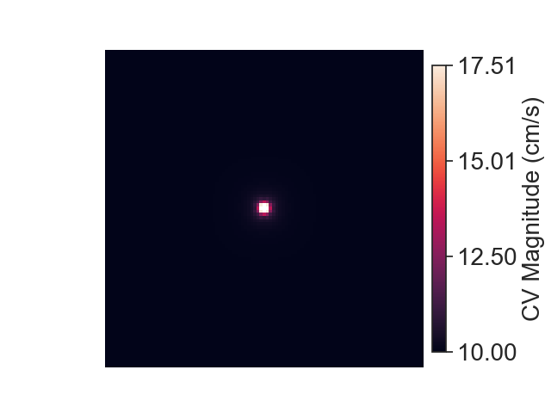
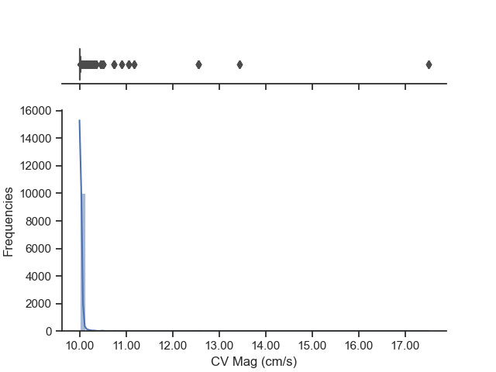
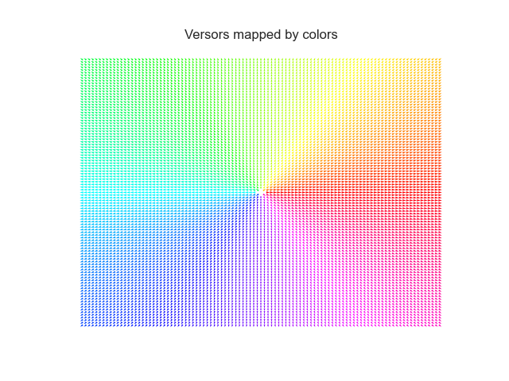
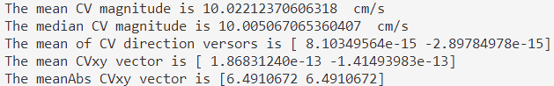
Sample: from center to the borders with AT= to the radius from the center. 101x101 image

Slide 6
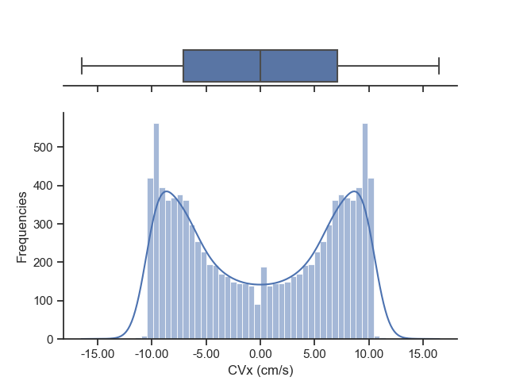

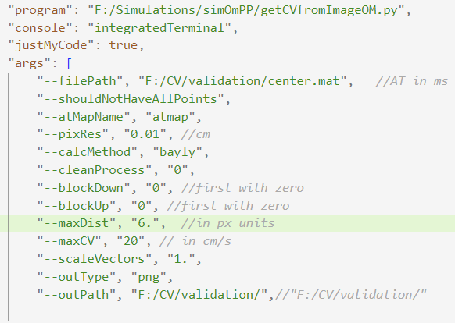
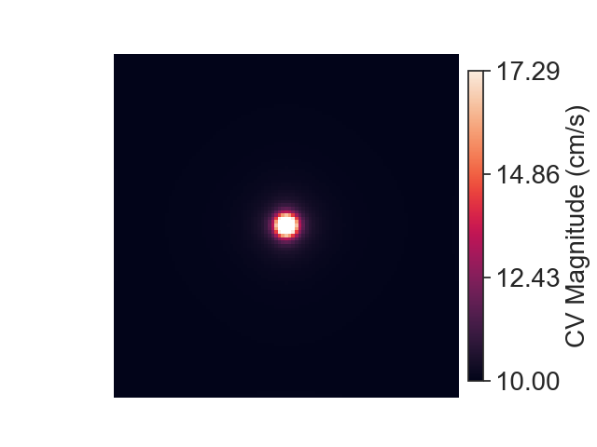
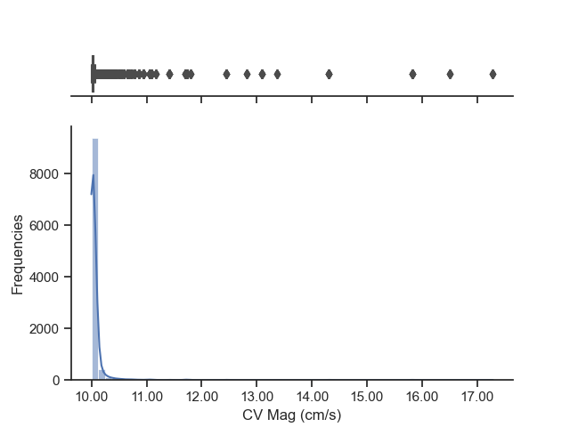
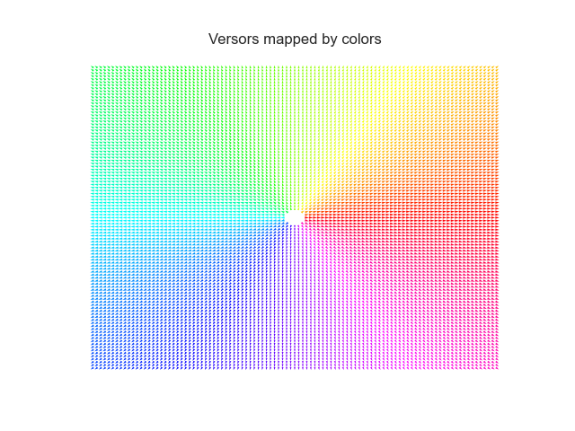
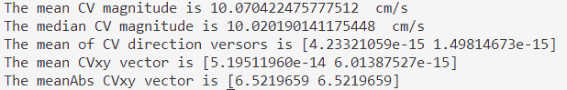
Sample: from center to the borders with AT= to the radius from the center. 101x101 image

Slide 7
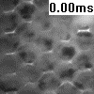
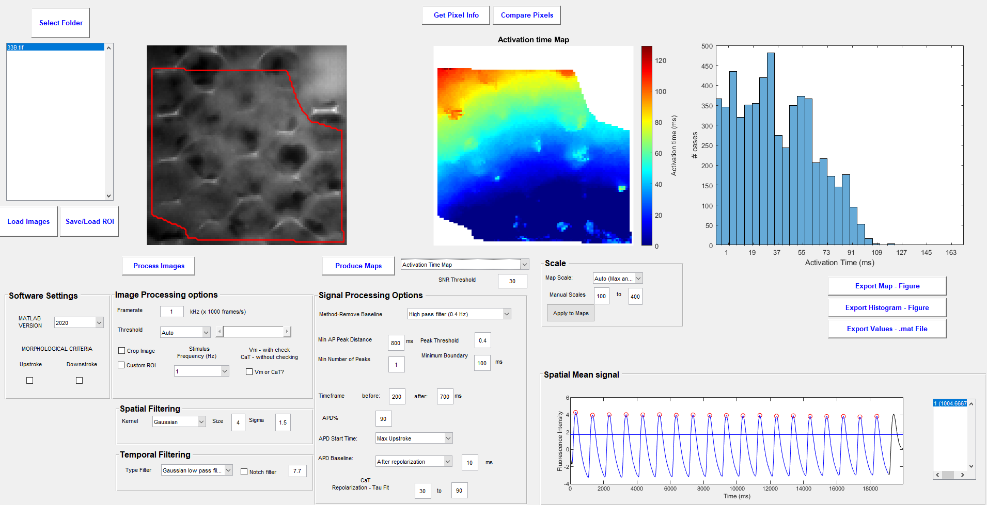
20220311
Sample33B: Hexagonal scaffold with CaT reactive dye.

Slide 8
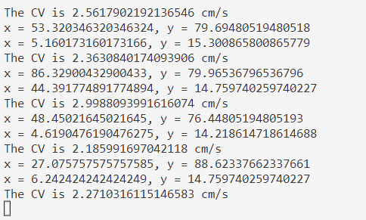
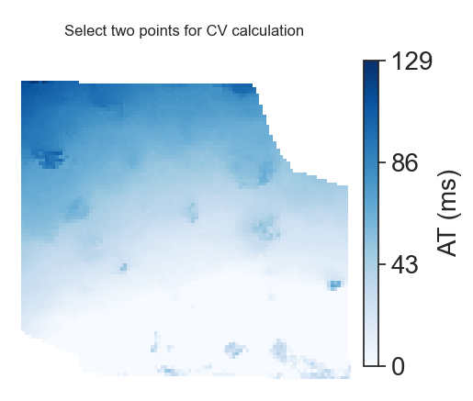
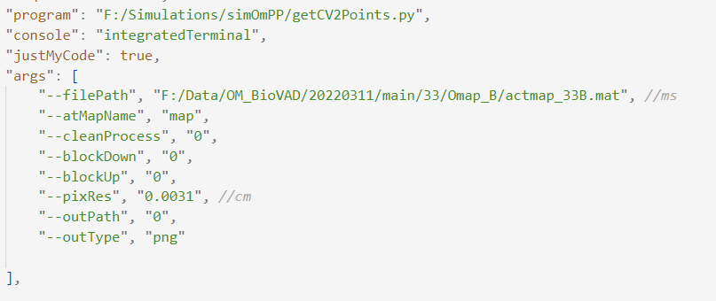
20220311
Sample33B: Two points algorithm
Taking different points for measuring the CV gives result from 2 to almost 3 cm/s.
The field of view of the camera is 3.1mm so as images of 100x100 pixels are obtained we have 0.031 mm/px resolution which is equal to 0.0031 cm pixel resolution.

Slide 9
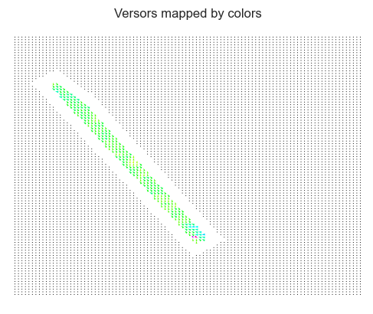
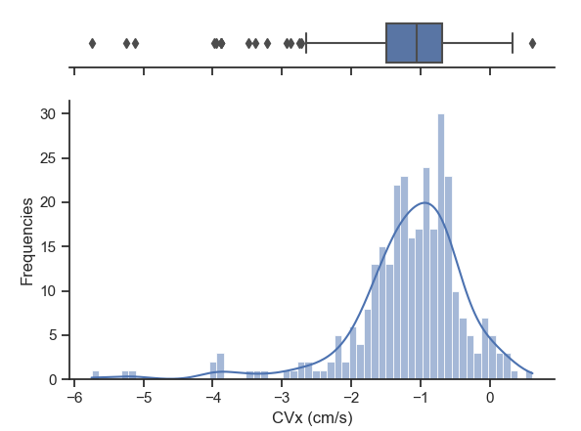
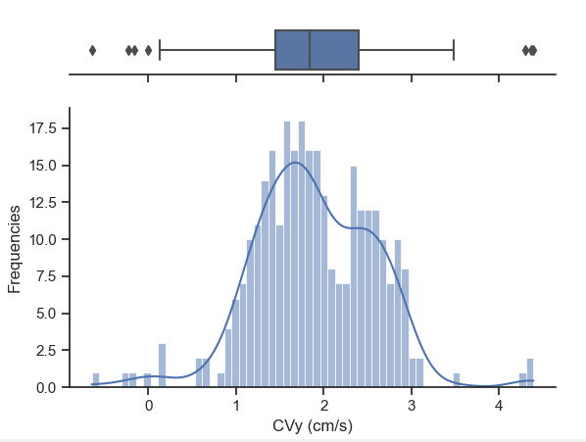

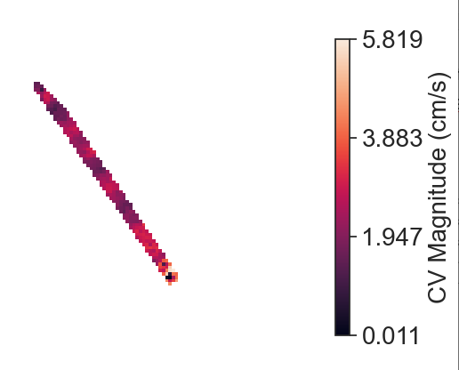
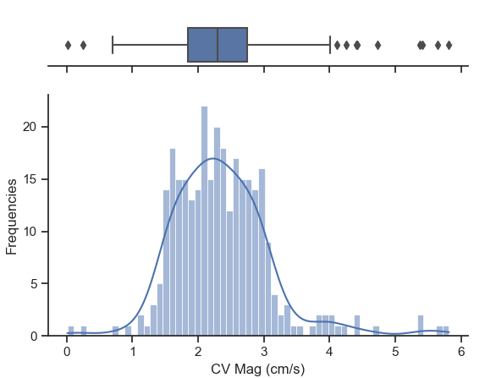

Sample33: Here we selected a ROI to avoid holes with no cells in the cellularized patch
CV mag is in agreement with the 2 points calculation.
Here we commented the –shouldNotHaveAllPoints argument that is the reason why a thinner CV map is obtained as we disregard the CV in the points in which all the AT values inside the circle determined by maxDist are not defined.

Slide 10








Sample33: Here we selected a ROI to avoid holes with no cells in the cellularized patch
CV mag has a mean of 3.68 and median of 2.16 cm/s which is in agreement with the 2 points calculation.
Also the Local CV vectors are mainly pointing correctly from bottom right to top-left.
Vectors mapped by colors has black dots outside the ROI, any dots for Nans in the CV calculation inside the ROI and Colored dots according to the CV direction in valid CV values.
Histograms are not fully seen due to outliers.

Slide 11







Sample: from center to the borders with AT= to the radius from the center.
Rays of high CV happens due to a really similar AT in the two pixels in black in the image, which are pixels in the wavefront. As the distance between them is not null a Really high CV is computed. If you see the rays of high CV are perpendicular to the wavefronts (spherical in this case). And the rays are not infinite cause numerically, times becomes zero in those zones, ergo the CV is assigned as nan and not used in the mean calculation for the final CV value in the pixel of interest. This could happen even if two points are consider in the local CV calculation when one is in one wavefront and another in his colliding one. Solved

